Slide 1

AN EVIDENTIAL APPROACH TO WELFARE ISSUES: THE EFFECT
OF WHIP USE ON STRIDE PARAMETERS
OF THE RACEHORSE
Katie Walker
An evidential approach to welfare issues: The effect of whip use on stride parameters of the racehorse:

Slide 2
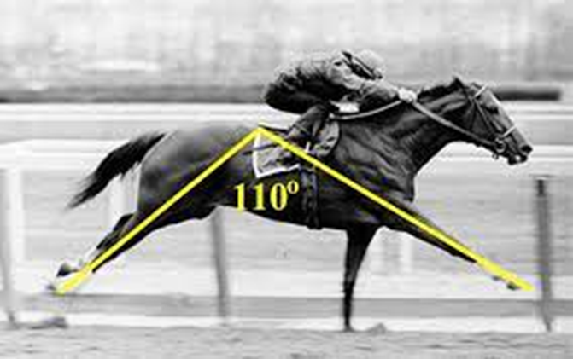

The effect of whip use on stride parameters of the racehorse: Implications on performance and how these can be used to address welfare issues.
Katie Walker: THIMBA Graduate and Equine Massage Therapist

Slide 3
The effect of whip use on stride parameters of the racehorse: Implications on performance and how these can be used to address welfare issues.
Katie Walker: THIMBA Graduate and Equine Massage Therapist

Slide 4

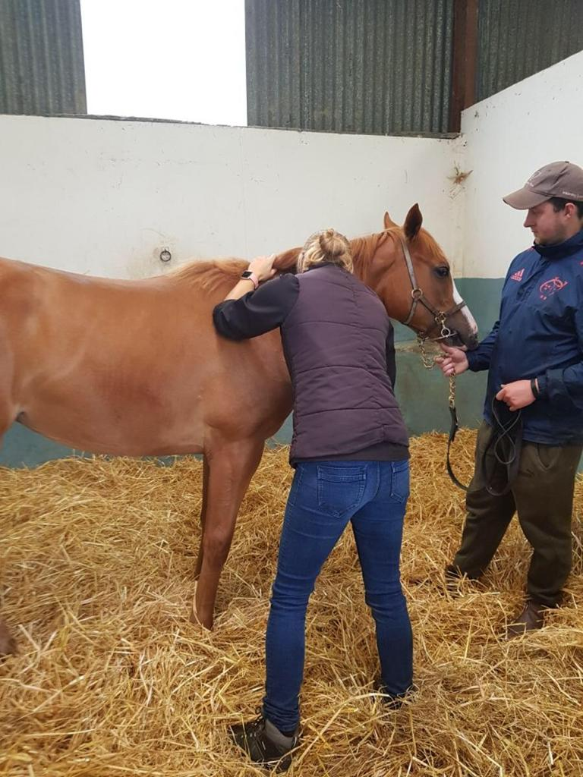
Background
Work based project for the Horserace Betting Levy Board to explore the justification of funding for sectional times/stride data
The importance of welfare to the future of the industry
The use of technology will be key and has been rather limited so far
This small study would have to be a precursor to further research
Katie Walker Equine Massage Therapy

Slide 5
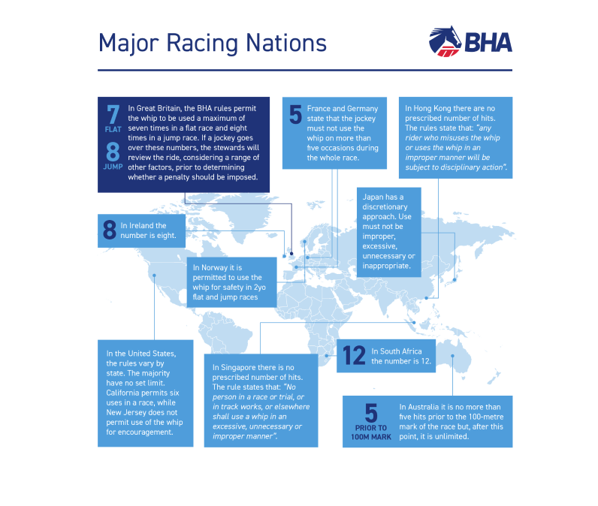
Why is scientific research important when debating the use of the whip?
The whip is a current hot topic
‘Use of the whip must not compromise the welfare of the horse’ (British Horseracing Authority)
‘Appropriate, proportionate and professional’ (Horse Welfare Board) – What do these statements actually mean?
Whip free racing in Norway whereas Japan and Singapore have no set rules and use a discretionary approach.

Slide 6
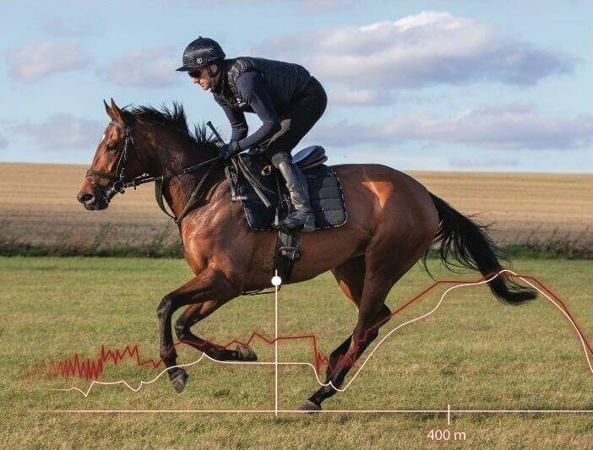
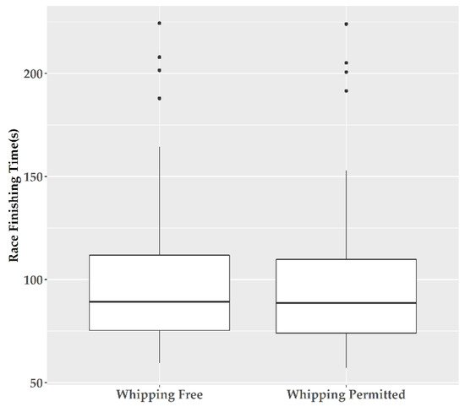
DATA TO BACK UP YOUR GUT FEELING.
Did your horse train in the proper intensity zone?
Is this horse fit enough to win his next race?
Will this horse be a future performer?
Which distance to race him according to his stride profile and acceleration strategy?
What is his top speed and ability to maintain it?
What is causing this horse to suddenly underperform?
Arioneo equimetre – use by trainers and vets
Science and best practice?
Finishing times in whipping free races v whipping permitted races (Thompson et al, 2020)
No significant decrease in finishing time when whip was present compared to whipping free races. (Thompson, et al, 2020)
Impact of fatigue is likely to cause some decline in stride parameters during closing stages (Takahashi et al, 2021)
Could the impact of the whip be better understood with the use of stride data?

Slide 7

The Project
Detailed collection of sectional times and stride data
Published on Attheraces
Analysis of the information
Data collected via the Total Performance Data archives from the launch of stride data in 2017 (limitations as only a 4 year period)
Selected to case match two sets – Hands and Heels (31 races were available on this platform during this time period totalling 295 runners) and Whipping permitted races (31 races totalling 300 runners).
Stride length and stride frequency in the final 3 furlongs were extracted, controlling for trip, ground, number of runners, quality of horse and course as far as possible.
Differences between professional jockeys and apprentice jockeys were recorded
Goal was to make recommendations for future studies that can improve equine welfare.

Slide 8
Key Findings
No significant difference in stride frequency between the two sets of data for all races
Small but significant difference in stride length between Whipping Permitted races compared to Hands and Heels races:
3f – 2f = 0.09m, 2f – 1f = 0.12 m and I f to finish = 0.05m
Division of data to use only all weather races (21 races from each set):
In races where horses were ridden by professional jockeys (147 runners) they had a 0.12m longer stride length compared to horses ridden by Hands and Heels apprentice jockeys in the case matched races. Taken on average over the last 3 furlongs.

Slide 9
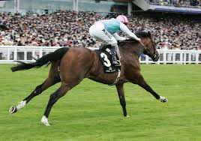
There had to be consideration for selection bias of horses selected for Hands and Heels races compared to Whipping Permitted races.
The choice of trainer to run a horse in hands and heels races
The stage of the horses career (and age)
The horse’s individual idiosyncrasies in selection for races
Further analysis could be made comparing changes in stride length within each set
Stride length measured at 27.3 ft in the Sussex Stakes 2011, TPD population average is 24.4ft.
Frankel

Slide 10
Stride length of Whipping Permitted horses decreased by 0.4m (5.7%) from the 3 furlong marker to the race finish, whereas Hands and Heels horse’s stride length decreased by 0.36m (5.2%).
Horses placed 1st, 2nd and 3rd in all races where then subdivided to find the stride length declines in the final 3 furlongs to account for those horses which were being eased off when out of contention. 93 runners in each set.
Horses placed 1st, 2nd, 3rd in the two sets of data | Stride Length decline (m) | Percentage decline of Stride Length
Hands and Heels race | 0.28 | 3.9%
Whipping Permitted race | 0.31 | 4.4%
Is the whip actually making a difference in the closing stages of the race?
No firm conclusions can be made here due to the limitations of the study. Highlights the need for further research.

Slide 11
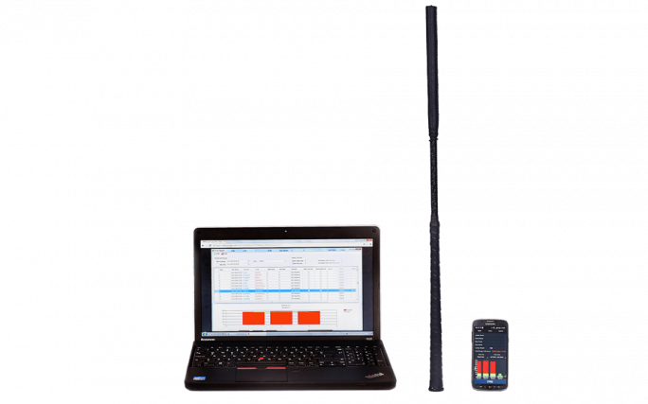
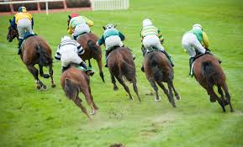
Recommendations for future research
Use stride parameters per second as opposed to averages over a furlong
Add whip counts for more detail
Sensors on whip can count both the strikes and the force (useful for stewards directly)
Better understanding of the going and how it effects individual horses

Slide 12
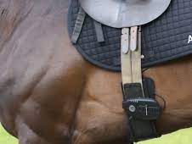
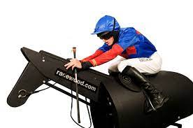
Specific relevance to welfare
Changes in stride parameters when fatiguing
Force of whip when used in forehand/backhand position, whip design, area of striking the horse and stage of gallop stride cycle when striking.
Expand to cardiac monitoring for signs of distress
75% of racecourse breakdowns are unexplained (no obvious external influence) (Parkin et al, 2006) – suggest investigation into rail (and jump placement in national hunt races). Do stride parameters provide a link to fallers/injuries accounting for these?
Jockey training - ability to keep the horse balanced and awareness of safety

Slide 13
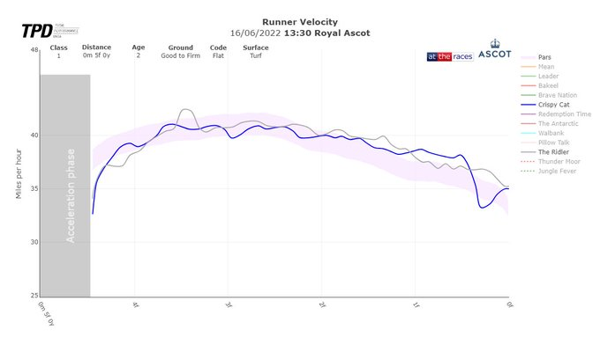
There was a stewards enquiry at Royal Ascot for the Norfolk Stakes, The Ridler was first past the post but caused interference to the 3rd and 4th placed horses. Places were unaltered but the jockey received a 10 day ban. This is Crispy Cat’s velocity throughout the race, he finished in third by just under 2 lengths. Could stewards be better informed with this technology??

Slide 14
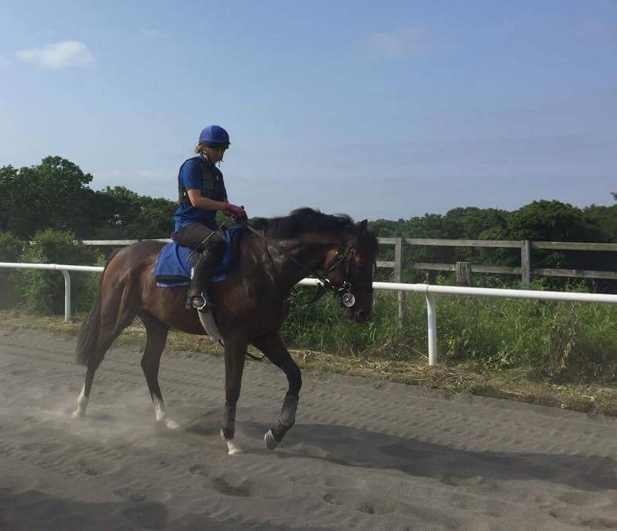
Thank you for listening
Katie Walker
ktwalks@outlook.com
Twitter :
@kwequinetherapy
@darkhorsescoop (racing blog)

Slide 15
Background
Work based project for the Horserace Betting Levy Board to explore the justification of funding for sectional times/stride data
The importance of welfare to the future of the industry
The use of technology will be key and has been rather limited so far
This small study would have to be a precursor to further research
Katie Walker Equine Massage Therapy

Slide 16
Why is scientific research important when debating the use of the whip?
The whip is a current hot topic
‘Use of the whip must not compromise the welfare of the horse’ (British Horseracing Authority)
‘Appropriate, proportionate and professional’ (Horse Welfare Board) – What do these statements actually mean?
Whip free racing in Norway whereas Japan and Singapore have no set rules and use a discretionary approach.

Slide 17
DATA TO BACK UP YOUR GUT FEELING.
Did your horse train in the proper intensity zone?
Is this horse fit enough to win his next race?
Will this horse be a future performer?
Which distance to race him according to his stride profile and acceleration strategy?
What is his top speed and ability to maintain it?
What is causing this horse to suddenly underperform?
Arioneo equimetre – use by trainers and vets
Science and best practice?
Finishing times in whipping free races v whipping permitted races (Thompson et al, 2020)
No significant decrease in finishing time when whip was present compared to whipping free races. (Thompson, et al, 2020)
Impact of fatigue is likely to cause some decline in stride parameters during closing stages (Takahashi et al, 2021)
Could the impact of the whip be better understood with the use of stride data?

Slide 18
The Project
Detailed collection of sectional times and stride data
Published on Attheraces
Analysis of the information
Data collected via the Total Performance Data archives from the launch of stride data in 2017 (limitations as only a 4 year period)
Selected to case match two sets – Hands and Heels (31 races were available on this platform during this time period totalling 295 runners) and Whipping permitted races (31 races totalling 300 runners).
Stride length and stride frequency in the final 3 furlongs were extracted, controlling for trip, ground, number of runners, quality of horse and course as far as possible.
Differences between professional jockeys and apprentice jockeys were recorded
Goal was to make recommendations for future studies that can improve equine welfare.

Slide 19
Key Findings
No significant difference in stride frequency between the two sets of data for all races
Small but significant difference in stride length between Whipping Permitted races compared to Hands and Heels races:
3f – 2f = 0.09m, 2f – 1f = 0.12 m and I f to finish = 0.05m
Division of data to use only all weather races (21 races from each set):
In races where horses were ridden by professional jockeys (147 runners) they had a 0.12m longer stride length compared to horses ridden by Hands and Heels apprentice jockeys in the case matched races. Taken on average over the last 3 furlongs.

Slide 20
There had to be consideration for selection bias of horses selected for Hands and Heels races compared to Whipping Permitted races.
The choice of trainer to run a horse in hands and heels races
The stage of the horses career (and age)
The horse’s individual idiosyncrasies in selection for races
Further analysis could be made comparing changes in stride length within each set
Stride length measured at 27.3 ft in the Sussex Stakes 2011, TPD population average is 24.4ft.
Frankel

Slide 21
Stride length of Whipping Permitted horses decreased by 0.4m (5.7%) from the 3 furlong marker to the race finish, whereas Hands and Heels horse’s stride length decreased by 0.36m (5.2%).
Horses placed 1st, 2nd and 3rd in all races where then subdivided to find the stride length declines in the final 3 furlongs to account for those horses which were being eased off when out of contention. 93 runners in each set.
Horses placed 1st, 2nd, 3rd in the two sets of data | Stride Length decline (m) | Percentage decline of Stride Length
Hands and Heels race | 0.28 | 3.9%
Whipping Permitted race | 0.31 | 4.4%
Is the whip actually making a difference in the closing stages of the race?
No firm conclusions can be made here due to the limitations of the study. Highlights the need for further research.

Slide 22
Recommendations for future research
Use stride parameters per second as opposed to averages over a furlong
Add whip counts for more detail
Sensors on whip can count both the strikes and the force (useful for stewards directly)
Better understanding of the going and how it effects individual horses

Slide 23
Specific relevance to welfare
Changes in stride parameters when fatiguing
Force of whip when used in forehand/backhand position, whip design, area of striking the horse and stage of gallop stride cycle when striking.
Expand to cardiac monitoring for signs of distress
75% of racecourse breakdowns are unexplained (no obvious external influence) (Parkin et al, 2006) – suggest investigation into rail (and jump placement in national hunt races). Do stride parameters provide a link to fallers/injuries accounting for these?
Jockey training - ability to keep the horse balanced and awareness of safety

Slide 24
There was a stewards enquiry at Royal Ascot for the Norfolk Stakes, The Ridler was first past the post but caused interference to the 3rd and 4th placed horses. Places were unaltered but the jockey received a 10 day ban. This is Crispy Cat’s velocity throughout the race, he finished in third by just under 2 lengths. Could stewards be better informed with this technology??

Slide 25
Thank you for listening
Katie Walker
ktwalks@outlook.com
Twitter :
@kwequinetherapy
@darkhorsescoop (racing blog)

