Slide 1
HORSE WELFARE BOARD UPDATE
Mike Etherington-Smith
Equine Safety Advisor at the Horse Welfare Board
Francesca Compostella
Aftercare Lead at the Horse Welfare Board
Horse Welfare Board Update

Slide 2
Horse Welfare Board Update

Slide 3
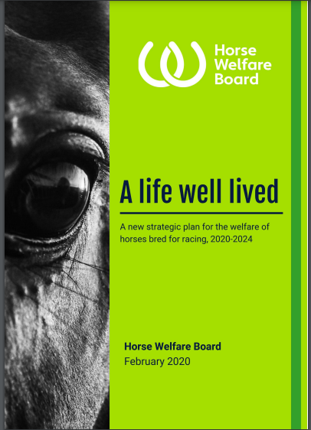
Horse Welfare Board & Strategy Introduction
Established in April 2019, in recognition of the need for greater cross-industry alignment and focus on welfare
Independent chairing and representation provides assurance that the Board will always take an objective approach, acting in the best interests of the horse
The Horse Welfare Board has produced a single, overarching strategy for equine welfare in the racing industry 'A life well lived'
The strategy considers the whole of the racing industry, including sectors not currently fully regulated by the British Horseracing Authority (BHA) and looks across the lifetime of all horses bred for racing

Slide 4
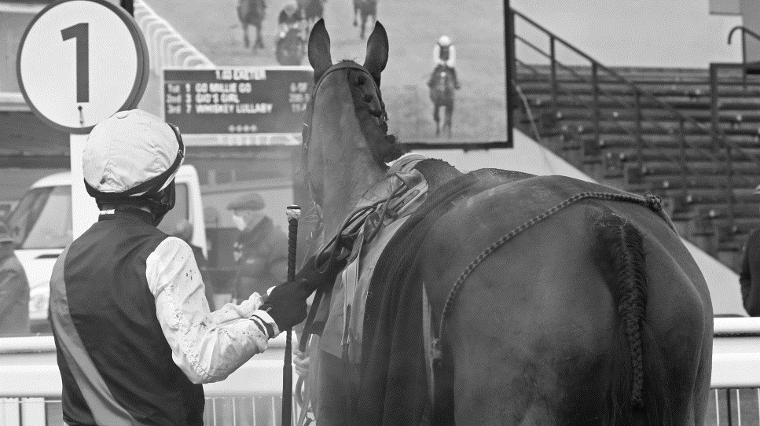
Objectives of the Horse Welfare Board
To achieve the best welfare outcomes possible for horses involved in British racing
To set out a vision and multi-year plan for horse welfare, based on shared industry priorities
To engage racing in the development of an industry strategy
To commission new projects and initiatives that may be required to deliver the plan
To continue to improve the safety of racehorses
To ensure effective use of the sport’s resources to achieve the vision
To ensure the sport benefits from an independent perspective on horse welfare, with a clear role for animal welfare bodies
To ensure more effective communication and engagement around equine welfare

Slide 5
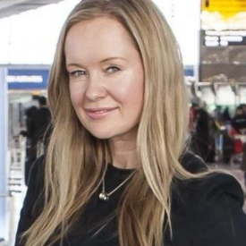
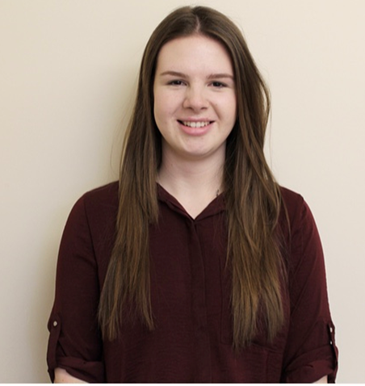
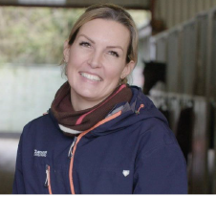
Horse Welfare Board Operational Team
Helena Flynn
Programme Director
Jessica Farr
Project Manager
Mike Etherington-Smith
Equine Safety Advisor
Steve Wensley
Welfare Data Project Lead
Francesca Compostella
Aftercare Project Lead

Slide 6
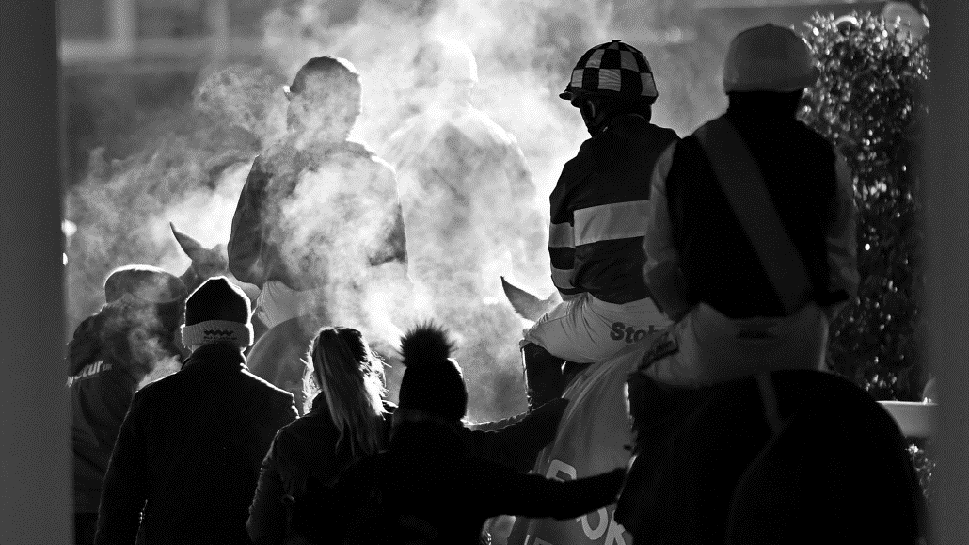
Full Project List
Welfare benchmarking tool
Training and CPD
Education of/support for rehomers and potential rehomers
Traceability
Welfare funding model
Euthanasia code/policy
Review of breeding, pre-training, sales and aftercare
Artificial insemination
Jump racing risk model (JRRM)
Racing fatalities occurring off the racecourse
Medication data and analysis
Rider engagement
Trainer engagement
Suitability to race
Ground/going research, development and training
Obstacle improvement and development
Stalls and starting review
Review of impact of prize money for lower placed horses
Fixture timing & allocation
The future of the whip
Welfare data programme and establishment of a welfare data unit
Thoroughbred Welfare Database
Communications strategy and plan
Promotional welfare communications plan
Corporate communications (welfare) plan
Code of ethics
Notes:
Within the life well lived strategy there are 26 projects of which the majority are scoped and live. They can be broken down into ¾ main areas which we will look at in a little more details now

Slide 7
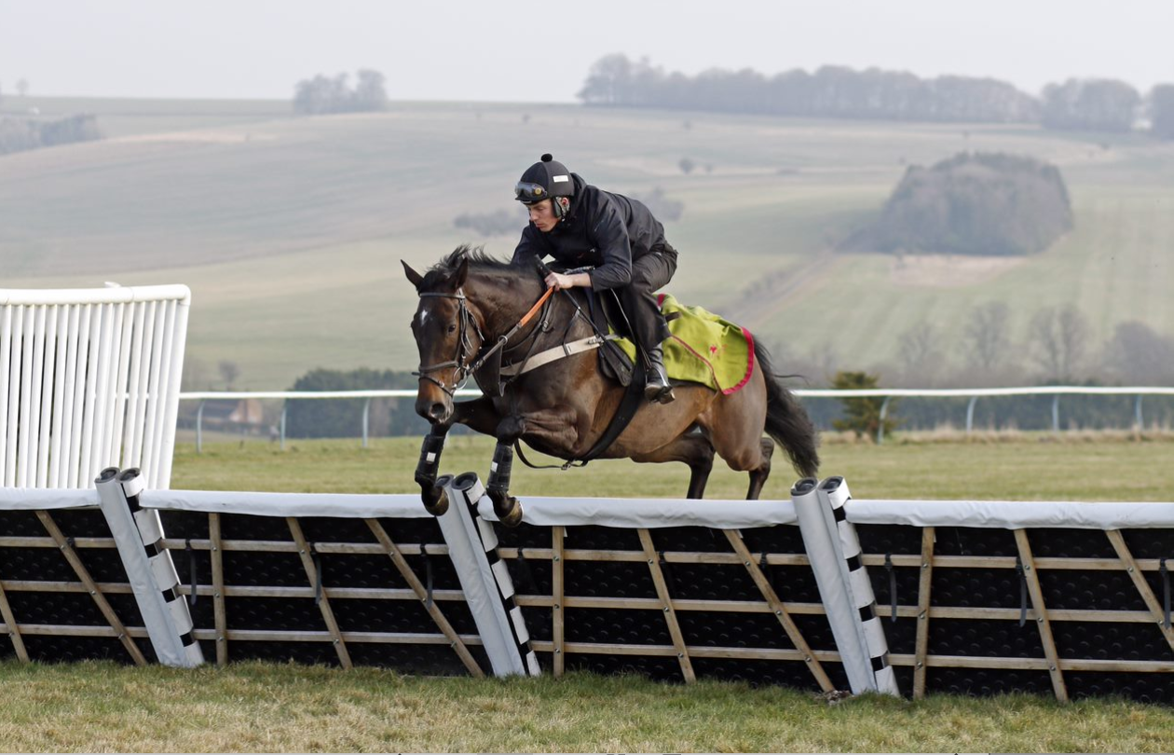
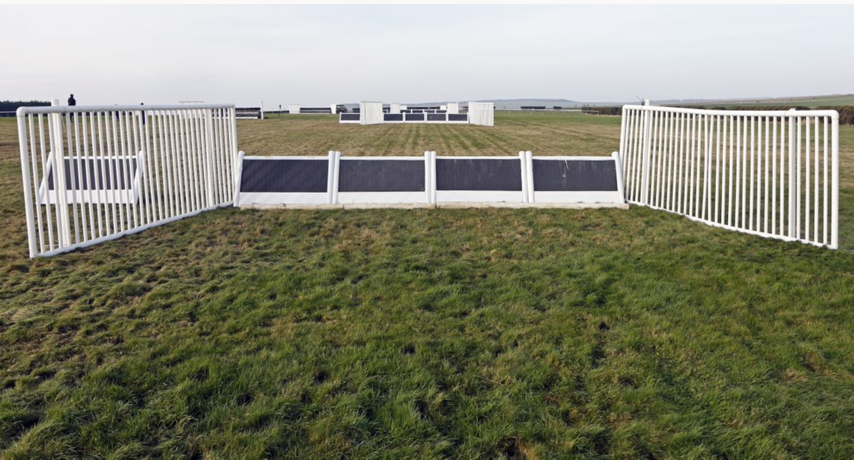
Best Possible Safety
Obstacle Improvement and Development
Orange to White roll out throughout 2022
Hurdle – existing design & future plastic/polymer/composite hurdle
Stalls and Starting Review
Review complete with cross industry working group
Recommendations shared with the HWB for approval
Ground and Going
Steering Group established to review BHAGI 3.2 – initial focus on racing surfaces
Priority to be completed throughout 2022

Slide 8
Traceability, Evidence and Data
Next steps:
Weatherbys and the development of the ePassport
Foal Crop Analysis with TBA to understand movement in the pre-training stages
Integrated responsible ownership plan working with the ROA
Welfare funding model for Aftercare (as per Aftercare Funding Review Recommendations)
Thoroughbred Welfare Database - funded by the Racing Foundation and in association with the University of Bristol to develop an integrated database. Recent focus on the development of faller, fatality, horses leaving training and foal crop reports.
Welfare Data Programme/Welfare Data Unit ongoing scoping of the project to ensure focus, alignment and prioritisation of data projects.
Work has commenced, utilising industry expertise, to scope additional data focused projects including the Medication and clinical records analysis and fatalities occurring off the racecourse

Slide 9
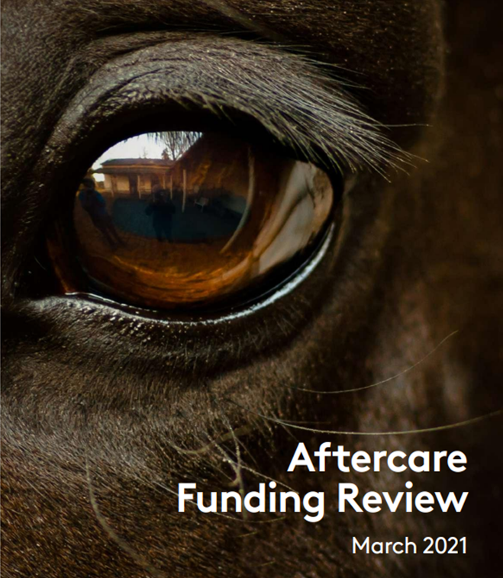
Aftercare
HWB issued the definition of the current “extent of racing’s responsibility” – prioritising projects
Expansion of the original “safety net” (vulnerable racehorses and first step out)
National funding call & pitch process – selecting a main aftercare centre for part of the safety net. Also setting the standards and procedures for all future funding opportunities.
Horse assessment AWAG welfare tool pilot
Accreditation system for Aftercare providers
Focus on education and sustainability – social license
Notes:
In the last 8 months the HWB achieved a consensus on the current extent of racing’s responsibility. This stemmed from numerous meetings held by a working and steering group, representing all of racing’s stakeholders.
Thanks to this definition, the aftercare funding review recommendations are now being implemented, following a priority list. With the first being an expansion of the original safety net, to include horses as they first retire from the sport.
To this effect a national finding call was held, engaging over 60 UK thoroughbred retrainers/rehomers, resulting in a centre of excellence being appointed.
At the same time an online welfare assessment tool designed by the university of Surrey is being tested, which promises real time assessment of these horses throughout their rehoming path. The AWAG tool has been extensively used in other contexts where animal welfare is monitored daily.
The next few months will see a greater engagement of service providers to focus on creating an accreditation system, ensuring consistency of practices and procedures across the country. This will strengthen collaborations within and outside the racing industry.
The focus on education is strongly supported by all, as a means to assure sustainability of the sector.

Slide 10
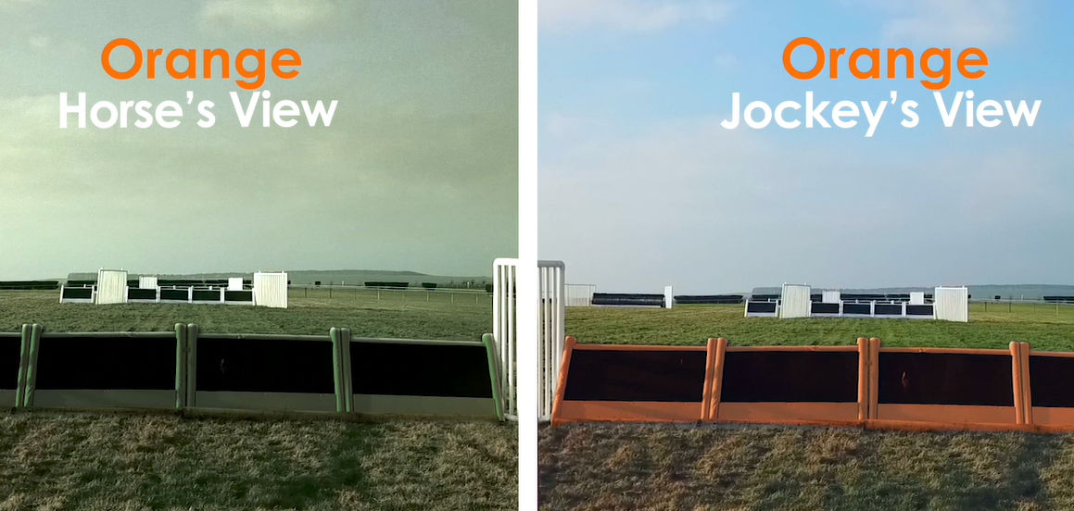
High Impact Communications
Welfare Communications Plan for 2022 agreed
Support on key HWB projects – notably Orange to White
Creation of various assets, content and videos as part of ongoing safety series – quarterly newsletter
Support around key Jumps Festivals
National Racehorse Week 10th – 18th September 2022
Trainer recruitment underway
Identified new opportunities and lessons learnt from year 1
Notes:
First issued in June, with deyails of the progress thus far. Copies are available upon request by contacting us on the HWB box email address on the final slide

Slide 11
THANK YOU
To the donors, in particular the Racing Foundation and HBLB for their ongoing support and guidance.
To all the participants of various working and steering groups, which are providing input and support on each project.
To all the operational staff delivering the work on the ground.

Slide 12
info@racehorsewelfare.co.uk

Slide 14
Extent of Racing’s Responsibility

