Slide 1
THE FINANCES OF BRITISH RACING
Peter Hawkings
Portas Consulting
The Finances of British Racing

Slide 2
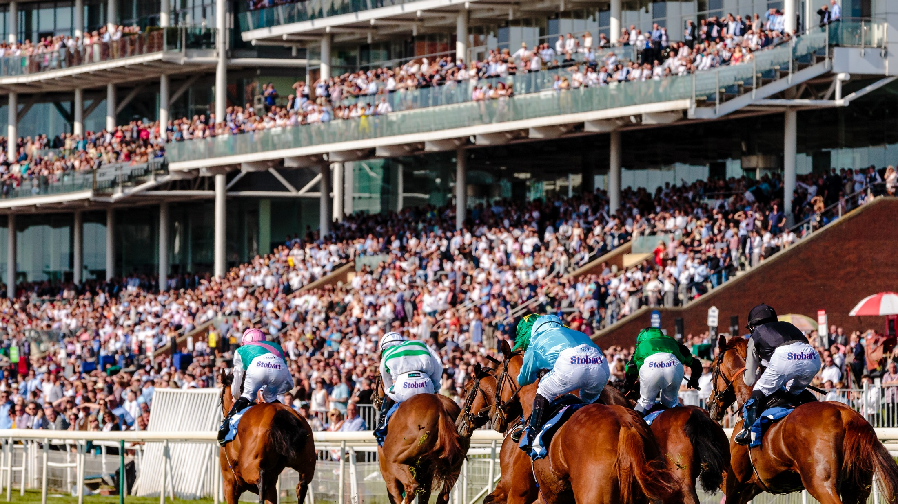
THE FINANCES OF BRITISH RACING
30th June 2022
This document is solely for client use. No part of it may be circulated, quoted, or reproduced for distribution outside the organisation without prior written approval from Portas Consulting

Slide 3
Contents
Contents
1
Where the money comes from
2
How the money flows through the sport
3
How racing’s finances compare with other sports
4
Financial opportunities and challenges facing British racing
2

Slide 4
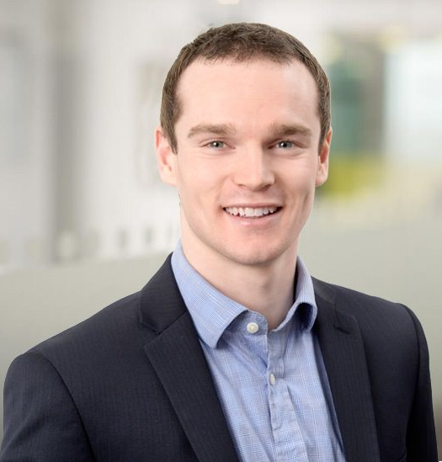
THE GLOBAL STRATEGY CONSULTANCY
DEDICATED TO SPORT AND PHYSICAL ACTIVITY
Peter Hawkings
Head of Sports Investments

Slide 5
Today there are 6 primary sources of money into racing
Financial inflows into racing, 2019
£’m
621
337
262
257
56
8
Owner gross expenditure
Breeder gross expenditure
Betting industry expenditure (media rights & levy)
Racegoer expenditure
Sponsorship
TV broadcast
Source: Portas analysis
Notes:
Largest individual owner breeder operations employ over 700 people with operating expenditure north of £50m p.a.

Slide 6
Racecourses and owner expenditure are the two primary conduits for money to flow into the industry
Media rights
Gross win from punters
Sponsors
Fans
Media firms
Bookmakers and tote
LBO Media rights
Levy yield
Racegoers spend
HBLB
Sponsorship revenue
Profit share
Racecourses
Other spend
Prize money
Prize money
Entry fees
Race day services
Prize money
Fixture incentives
Ownership and horse population promotion
Jockey fees
Owners
Jockey fees
Purchases
Training fees
Jockeys
Trainers
Auction House
Salaries and share of prize pool
Purchase price less commission
Stable Staff
Breeders
Salaries
Source: Portas analysis

Slide 7
These distributions support thousands of businesses, although many face financial challenges
Stakeholder
Number
Illustration of financial position/challenge
Racecourses
59
Average free cash flow from racing activities is £220k
The cumulative net debt position was -£455m in 2020
Owners
13,500
Average ROI of flat owner is 20%
Average ROI of jump owner is 17%
Breeders
3,300
66% of breeders are unprofitable
Licensed jockeys
400
The median flat jockey has gross earnings of £29,000
The median jump jockey has gross earnings of £14,000
Trainers
500
c. 75% of trainers break even or make losses
*Excludes non-racing activities
Sources: BHA annual racing statistics & annual reports 2020, 2019 and 2015; Racing Foundation Review of 2018; TBA Economic Impact Study; Portas analysis
6

Slide 8
Prize money is a key income stream for horsemen, but compares unfavourably to other jurisdictions
Total prize money
£’ m
Average prize money per race
£’000
874
155
720
365
53
168
166
24
126
22
20
19
57
16
Sources: Portas analysis, Racing Post
Notes:
Appreciate all markets have different structures around things such as betting privatisation and mechanisms, ways that ecosystem interacts

Slide 9
Revenue breakdown varies widely between large, small and AWT racecourses
Revenue breakdown large racecourses
%
Revenue breakdown small racecourses
%
Revenue breakdown AWT racecourses
%
3%
3%
2%
4%
Racegoer expenditure
Sponsorship
Betting income (media rights and levy)
Owner entry fees
Sources: RCA finance presentation, Portas analysis

Slide 10
Comparing horseracing to other sports highlights the unique importance of owners and betting in the industry’s business model
Relative composition of industry inflows
£‘ m
Potential learnings
1,203
6,007
309
413
Horseracing is a unique business model – it relies on owners being prepared to spend without expecting returns and for the symbiotic relationship with betting to continue
Other sports have built business models more oriented towards direct-to-fan revenues
Rugby remains primarily an attendance driven business
Cricket performs strongly commercially in broadcast and sponsorship rights
0%
0%
1%
0%
Owner expenditure
Betting industry expenditure
TV
1%
Matchday/race day expenditure
Non-betting sponsorship
Horseracing
Football
Rugby
Cricket
Note: excludes breeder expenditure
Sources: Portas analysis, Global Data, RFU, The Guardian, ECB, SportsProMedia
Notes:
8 out of 20 of EPL clubs have betting partners front of shirt

Slide 11
Seven potential levers to improve British racing’s financial position
Build relationships with fans and make the sport more relevant
Create new, exciting racing formats and create greater narratives across the year
Convert more fans to becoming fractional owners (syndicates)
Secure owners in new geographies
Optimise as a betting product
Achieve meaningful levy reform
Racecourses diversify revenue streams e.g. becoming more of a 365-day event destination
Source: Portas analysis
Notes:
If racing does nothing, our analysis indicates that racing industry would have a low growth rate over next 5 years

Slide 12
Some of the big questions to achieve a sustainable financial future for the sport…
What will it mean to a Gen Z person to be a fan of racing and to own a racehorse in 10-years+ time?
Will British racing be able to retain its international prestige and premium without unwavering royal support?
What role should betting play in the future of racing?
How can racing and breeding organise itself to collectively respond to these challenges?
Source: Portas analysis

